Slide 1
Smart Event Planning & Resource Management System
Introduction and Milestone 1

Slide 2
Introduction to the Topic: Event Planning & Resource Management System
EventSphere is a web-based Event Planning and Resource Management System designed to make event organization easier, more efficient, and centralized.
Organizing an event involves many activities such as creating the event, booking venues, managing resources, registering attendees, coordinating vendors, tracking expenses, and monitoring the overall event. Traditionally, these activities may be handled using spreadsheets, emails, messaging applications, and separate tools, which can lead to scheduling conflicts, budget issues, communication problems, and difficulty tracking the event in real time.
EventSphere brings these activities together into one unified platform. An organizer can create an event, specify its requirements, allocate venues and resources, manage vendors, register attendees, monitor the budget, and track the progress of the event through dashboards.

Slide 3
What will we learn/build?
During this project, we will work with concepts such as:
Event Management – creating, updating, scheduling, and managing events.
Resource Management – managing venues, equipment, staff, transportation, and other resources.
Attendee Management – registration, digital tickets, QR-code check-in, and attendance tracking.
Vendor Management – onboarding vendors, contracts, service assignments, and communication.
Budget Management – tracking planned budgets, expenses, sponsorship revenue, and financial performance.
REST APIs – allowing different parts of the application to communicate with each other.
Workflow Automation – automating approvals, notifications, reminders, and alerts.
Analytics – understanding attendance, resource usage, budget performance, and operational efficiency.

Slide 4
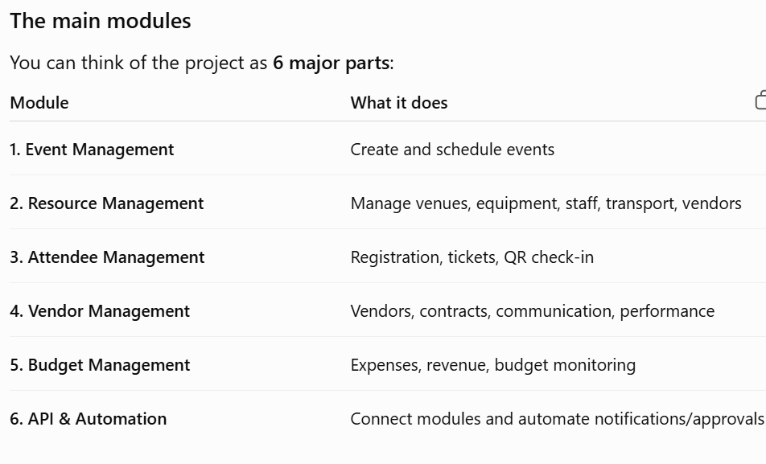

Slide 5
What happens when someone uses EventSphere?
A simple flow would be:
Organizer → Create Event → Select Venue → Allocate Resources → Add Vendors → Open Registration → Generate Tickets → Event Day → QR Check-in → Track Expenses → View Reports

Slide 6
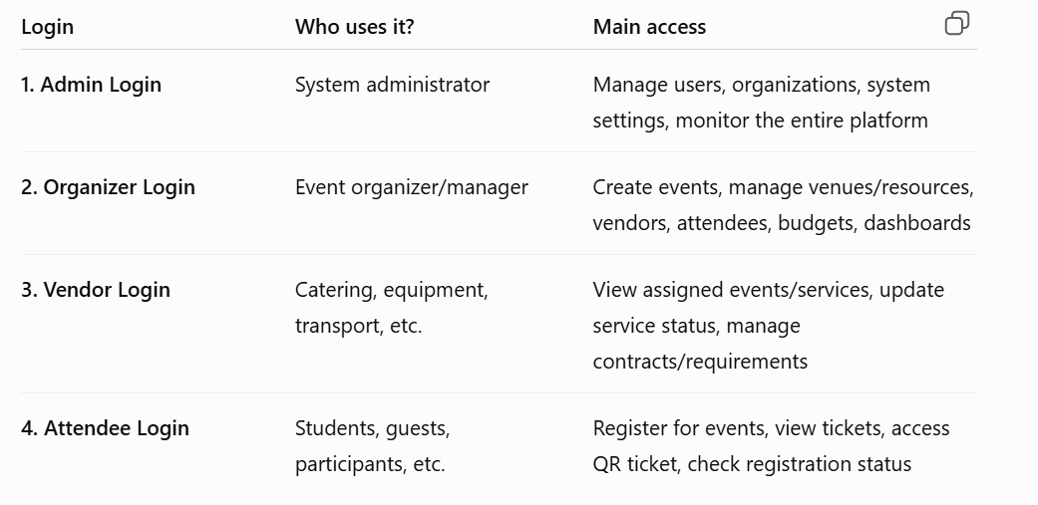

Slide 7
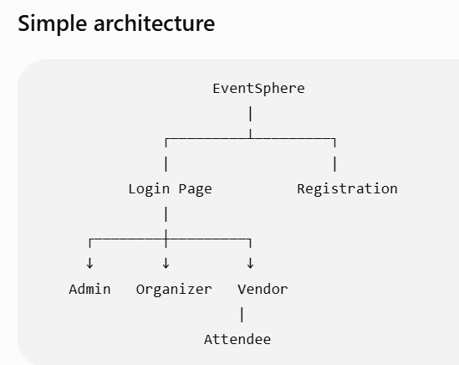

Slide 8
Milestone 1
event creation, scheduling, database design, resource allocation, venue reservation, and scheduling validation.

Slide 9
Day 1 — Introduction + Event Management
Topics to teach
Introduction to EventSphere
Understanding the problem statement
Project modules
User roles
Frontend vs Backend vs Database
What is CRUD?
Event creation and management

Slide 10
Introduction to EventSphere: A system to plan and manage events in one place.
Problem Statement: Managing events manually can cause scheduling conflicts and difficulty tracking resources.
Project Modules: Events, venues, resources, attendees, vendors, and budget.
User Roles: Admin, Organizer, Vendor, and Attendee.
Frontend vs Backend vs Database: Frontend is what users see, backend handles logic, and database stores information.
What is CRUD?
C – Create (add an event)
R – Read (view events)
U – Update (edit event details)
D – Delete (remove an event)
Practical Task: Build a basic event form with event name, type, date, and budget.

Slide 11
Introduction: What is EventSphere?
Learn: Basic event management and UI design.
Practical Task: Create a simple event form.
Fields: Event Name, Date, Type, and Budget.
Outcome: Build a basic event management page.

Slide 12
Intern Task 1 — Create Event Module
Build an Event Management module where an organizer can:
Create an event
View all events
View event details
Edit an event
Delete an event

Slide 13
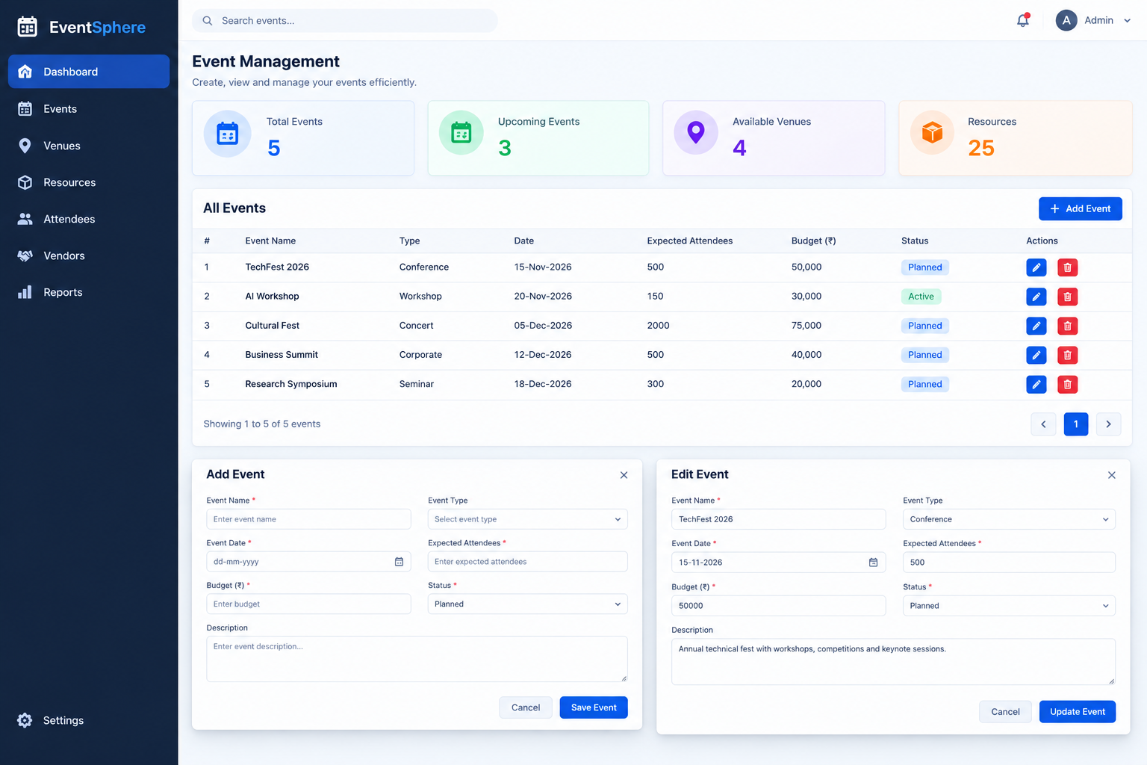

Slide 14
Day 2 — Database + Venue Management
Topics to teach
What is a database?
Tables and relationships
Primary key
Foreign key
SQL basics
Connecting application with database
Venue management
The project requires a centralized repository for venues and resources.

Slide 15
Database & Venue Management
Topics: Database basics, tables, relationships, and venue management.
Learn: How to store event and venue details.
Practical Task: Create database tables for Events and Venues.
Features: Add, view, edit, and delete venues.
Outcome: Connect events with venues and store data in the database.

Slide 16
Intern Task 2 — Venue Management
Create a Venue Management module.
Each venue should contain:
Venue ID
Venue Name
Location
Capacity
Availability
Cost Per Day
Example:
V001 | Main Auditorium | Chennai | 1500 | Available | ₹75,000
V002 | Seminar Hall A | Chennai | 200 | Available | ₹20,000
V003 | Convention Hall | Chennai | 800 | Booked | ₹60,000

Slide 17
Additional task
When creating an event, allow the organizer to select a venue.
The system should check:
Expected Attendees <= Venue Capacity
If not:
❌ "Selected venue does not have sufficient capacity."
Day 2 Submission:
Database schema + Venue CRUD + Event-Venue connection.

Slide 18
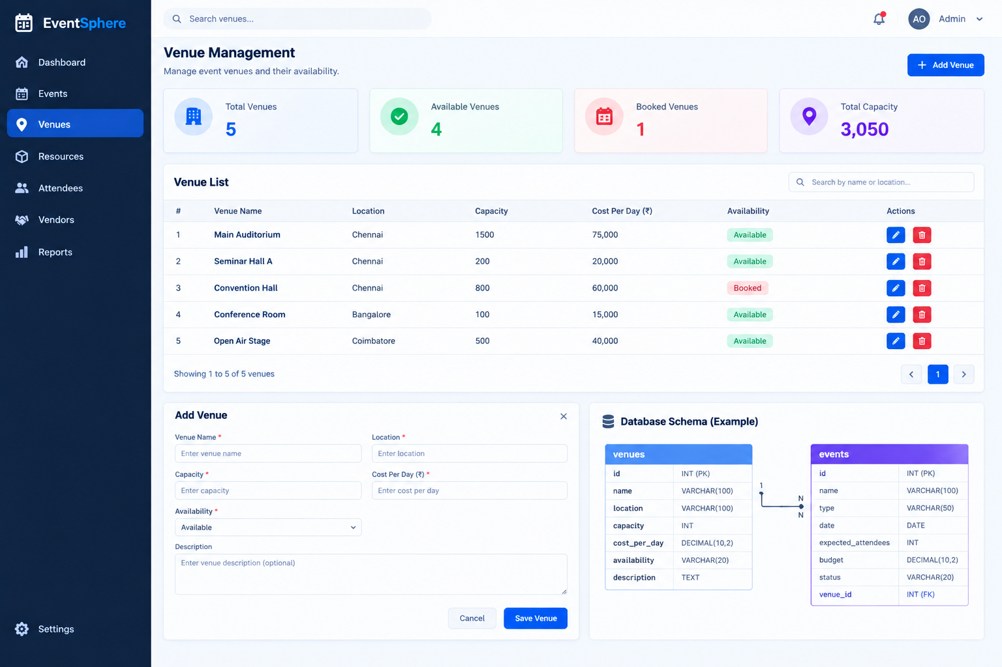

Slide 19
Day 3 — Resource Management
Topics to teach
Explain what resources mean in event management.
Examples:
Projectors
Microphones
Chairs
Laptops
Staff
Security
Transportation
The project requires resource allocation based on event requirements and availability

Slide 20
Resource Management
Learn: How to manage event resources such as projectors, microphones, chairs, and laptops.
Topics: Add, view, update, and delete resources.
Practical Task: Create a resource management page.
Features: Resource name, quantity, availability, and status.
Outcome: Allocate resources to events and avoid double booking.

Slide 21
Intern Task 3 — Resource Management
Create a Resource Management module.
Resource fields:
Resource ID
Resource Name
Resource Type
Quantity
Available Quantity
Status
Example:
R001 | Projector | Equipment | 10 | 10 | Available
R002 | Microphone | Equipment | 20 | 15 | Available
R003 | Security Staff | Staff | 30 | 30 | Available
R004 | Bus | Transport | 5 | 5 | Available

Slide 22
Allocation task
For TechFest 2026, allocate:
Projector → 5
Microphone → 10
Security Staff → 20
Bus → 2
The system should reduce the available quantity after allocation.
Example:
Before:
Projectors = 10 Available
Allocate 5
After:
Projectors = 5 Available
Day 3 Submission:
Resource CRUD + resource allocation functionality.

Slide 23
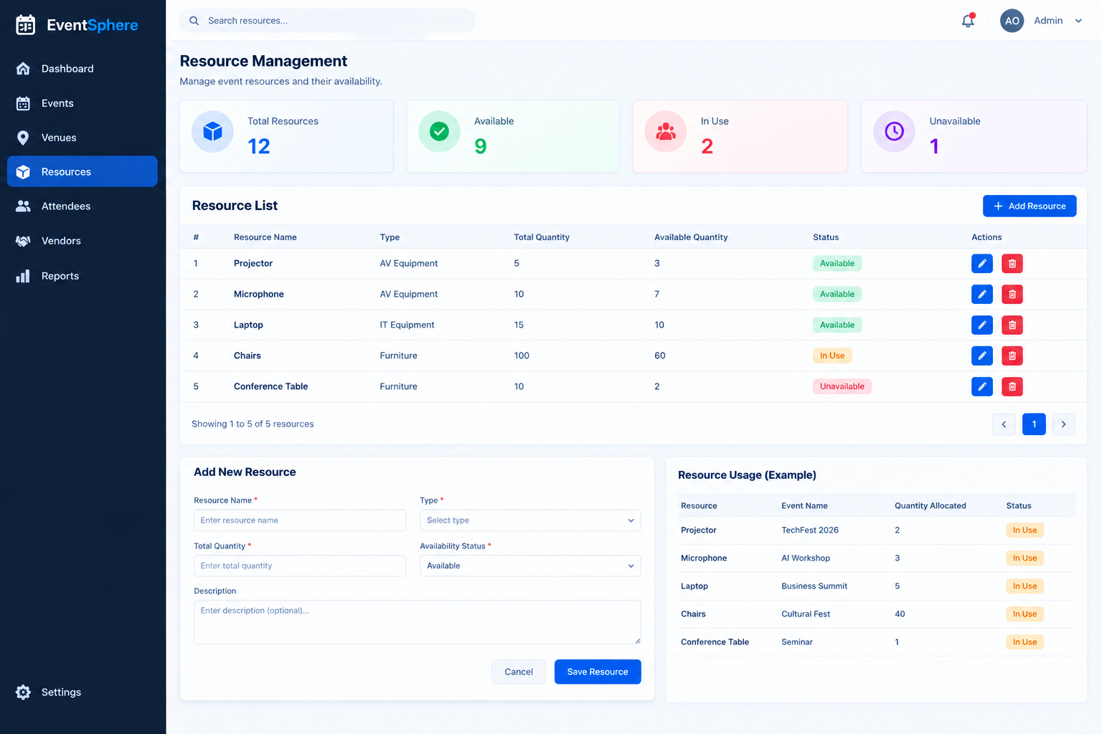

Slide 24
Day 4 — Scheduling + Conflict Detection
This is an important part of Milestone 1 because the project requires venue booking management with conflict detection and scheduling validation.
Topics to teach
Event scheduling
Date and time
Availability
Booking conflicts
Validation logic
Basic business rules

Slide 25
Intern Task 4 — Conflict Detection
Suppose:
Event 1
TechFest
Venue: Main Auditorium
Date: 15-Nov-2026
Time: 10 AM – 1 PM
Now the organizer tries:
Event 2
AI Conference
Venue: Main Auditorium
Date: 15-Nov-2026
Time: 12 PM – 3 PM
The system should display:
❌ Venue Conflict: Main Auditorium is already booked during this time.
But if:
AI Conference
Venue: Main Auditorium
Date: 16-Nov-2026
Time: 10 AM – 1 PM
Then:
✅ Venue Available — Booking Confirmed.

Slide 26
Resource conflict
Do the same for resources.
For example:
TechFest → Projector 1
10 AM – 1 PM
Another event:
Workshop → Projector 1
11 AM – 12 PM
The system should detect:
❌ Projector already allocated during this period.
Day 4 Submission:
Scheduling module + venue/resource conflict detection.

Slide 27
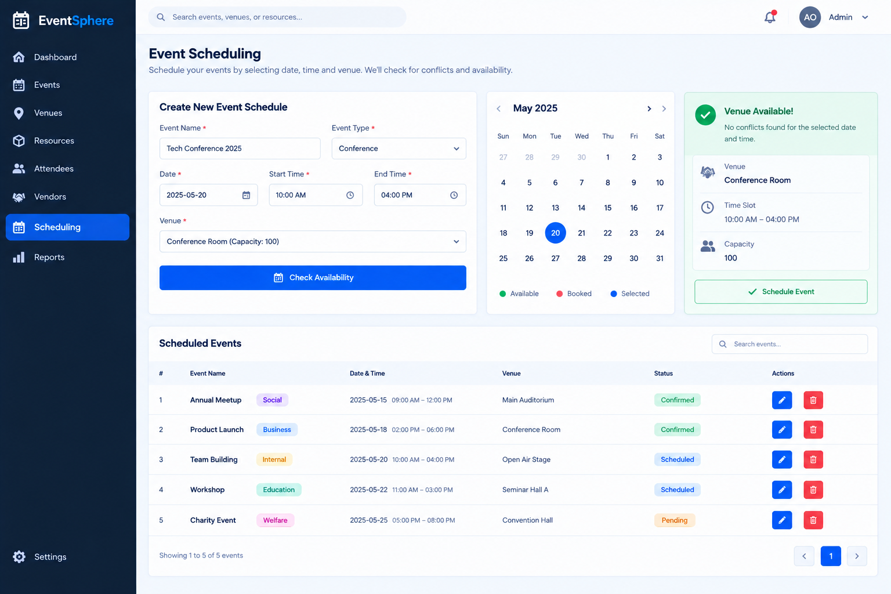

Slide 28
Day 5 — Integration + Mini Project
Day 5 should be an intern assignment day, rather than introducing a lot of new concepts.
Final Task — Build a Mini Event Management System
Give them this requirement:
Build a basic event management system for a college technical event using everything learned during Days 1–4.

Slide 29
Login
↓
Dashboard
↓
Create Event
↓
Select Venue
↓
Check Capacity
↓
Schedule Event
↓
Check Venue Conflict
↓
Allocate Resources
↓
Check Resource Availability
↓
Confirm Event
↓
Display Event Details

Slide 30
Minimum features
1. Event Management
Create
Read
Update
Delete
2. Venue Management
Add venue
View venues
Check availability
Assign venue
3. Resource Management
Add resources
View resources
Allocate resources
Check availability

Slide 31
4. Scheduling
Date/time selection
Venue conflict detection
Resource conflict detection
5. Dashboard
Display:
Total Events: 5
Upcoming Events: 3
Available Venues: 4
Resources: 25

Slide 32
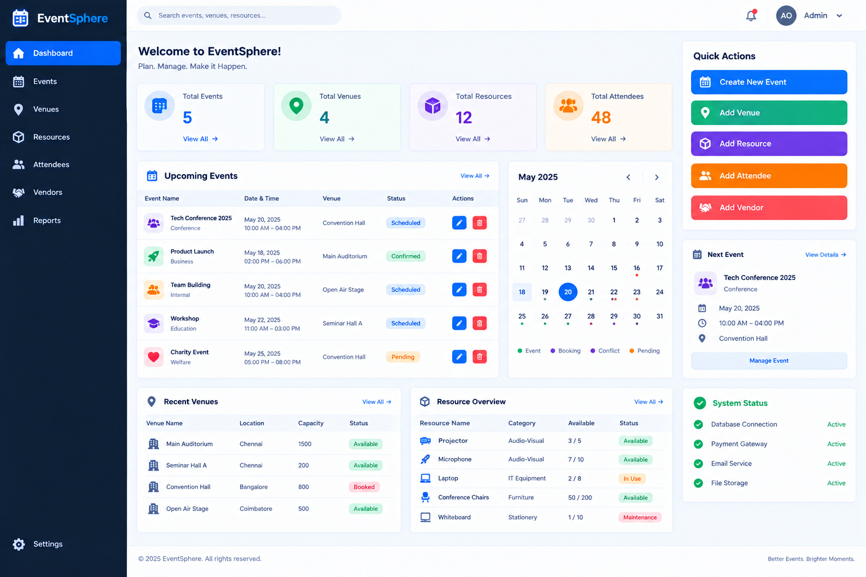

Slide 33
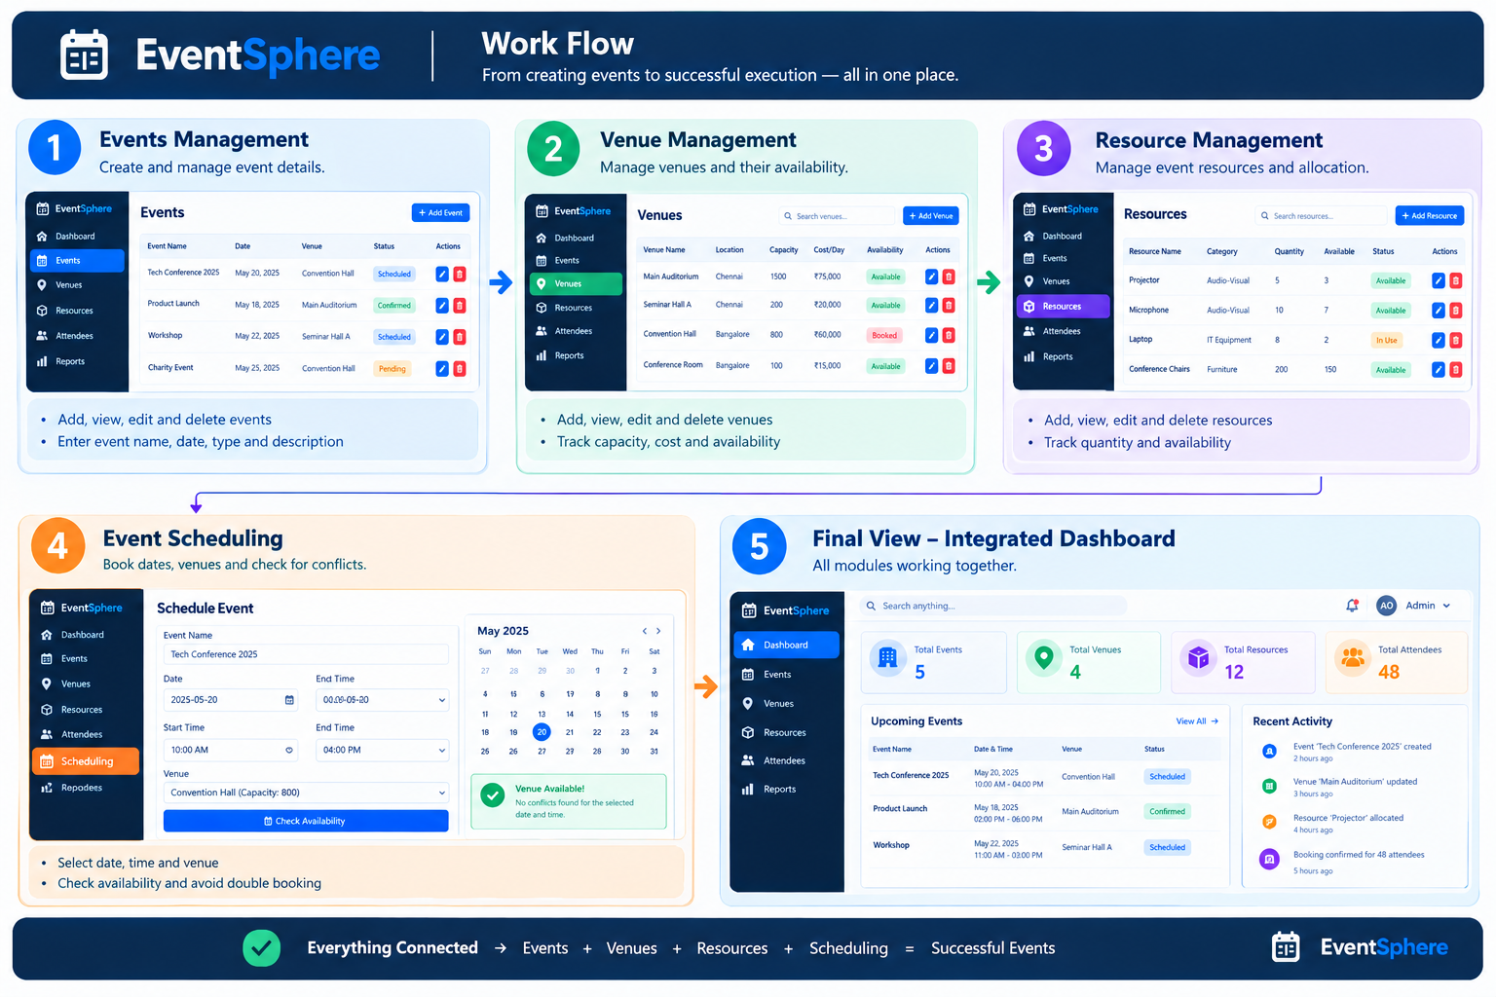

Slide 34
EventSphere — Milestone 1 Deliverables
Milestone 1: Event Planning & Resource Foundation
Event Management Module — Create, view, edit, and delete events.
Database Design — Create tables for events, venues, resources, and attendees.
Venue Management — Add venues and manage their capacity and availability.
Resource Management — Track resources, quantities, and availability.
Event Scheduling — Schedule events by date and venue.
Conflict Detection — Prevent venue double-booking and scheduling conflicts.
Basic Reports — Display event details, schedules, and resource availability.
Testing & Documentation — Test the modules and document the project.

